Slide 1
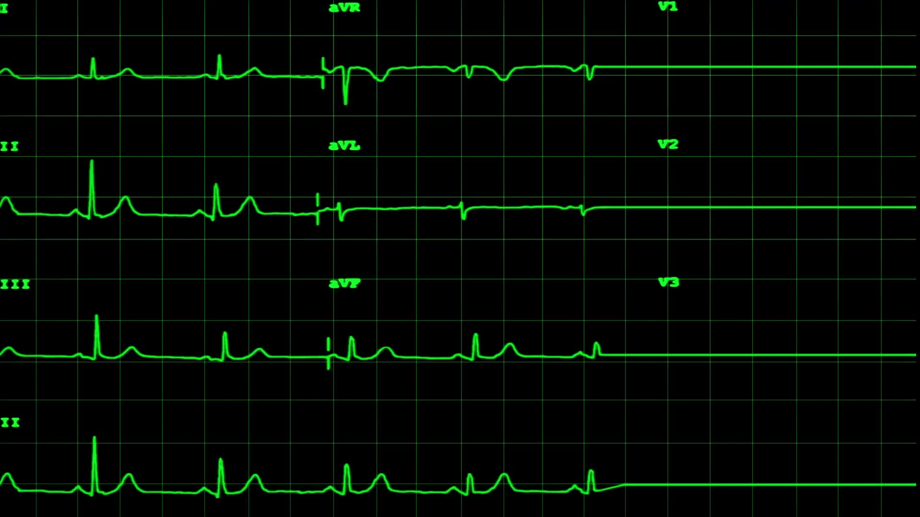
Heart Disease Prediction
Using Machine Learning to Predict Heart Disease
Sree Sravya Tumuluri
DS520

Slide 2
Introduction
Project Objective: Develop a classification model to predict the presence of heart disease based on various health metrics and patient demographics.
Significance: Heart disease is a leading cause of mortality worldwide. Accurate prediction can improve patient outcomes and reduce healthcare costs.
Personal Interest: Combines my passion for healthcare and technology.

Slide 3

Dataset Overview
Heart Disease UCI Dataset:
Attributes: Age, sex, chest pain type, resting blood pressure, serum cholesterol, fasting blood sugar, resting electrocardiographic results, maximum heart rate achieved, exercise-induced angina, ST depression induced by exercise, slope of peak exercise ST segment, number of major vessels, categorical variable for heart disease presence.
Cardiovascular Disease Dataset:
Attributes: Age, gender, height, weight, blood pressure, cholesterol, glucose, smoking, alcohol intake, physical activity, presence of cardiovascular disease.
Size: 70,000 records of patients.

Slide 4
Methodology
Data Collection: Utilize the Heart Disease UCI and Cardiovascular Disease datasets.
Data Preprocessing: Handle missing values, normalize/standardize data, encode categorical variables.
Feature Engineering: Create new features from existing data, select important features.
Model Selection: Choose various classification algorithms (e.g., Logistic Regression, Decision Trees, Random Forest, SVM, Neural Networks).
Model Training: Split data into training and test sets, train models using cross-validation.
Model Evaluation: Evaluate models using accuracy, precision, recall, F1-score, ROC-AUC.

Slide 5
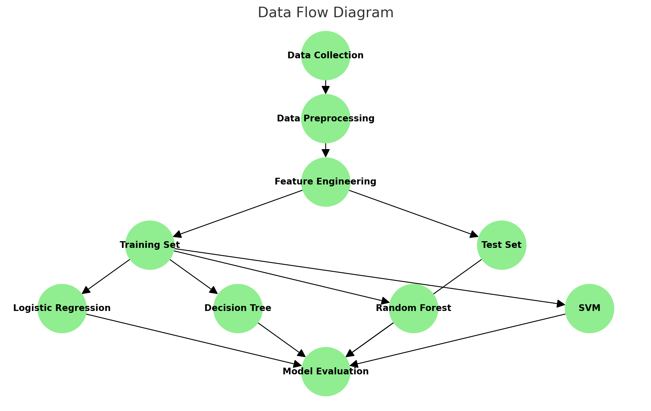
Data flow diagram

Slide 6
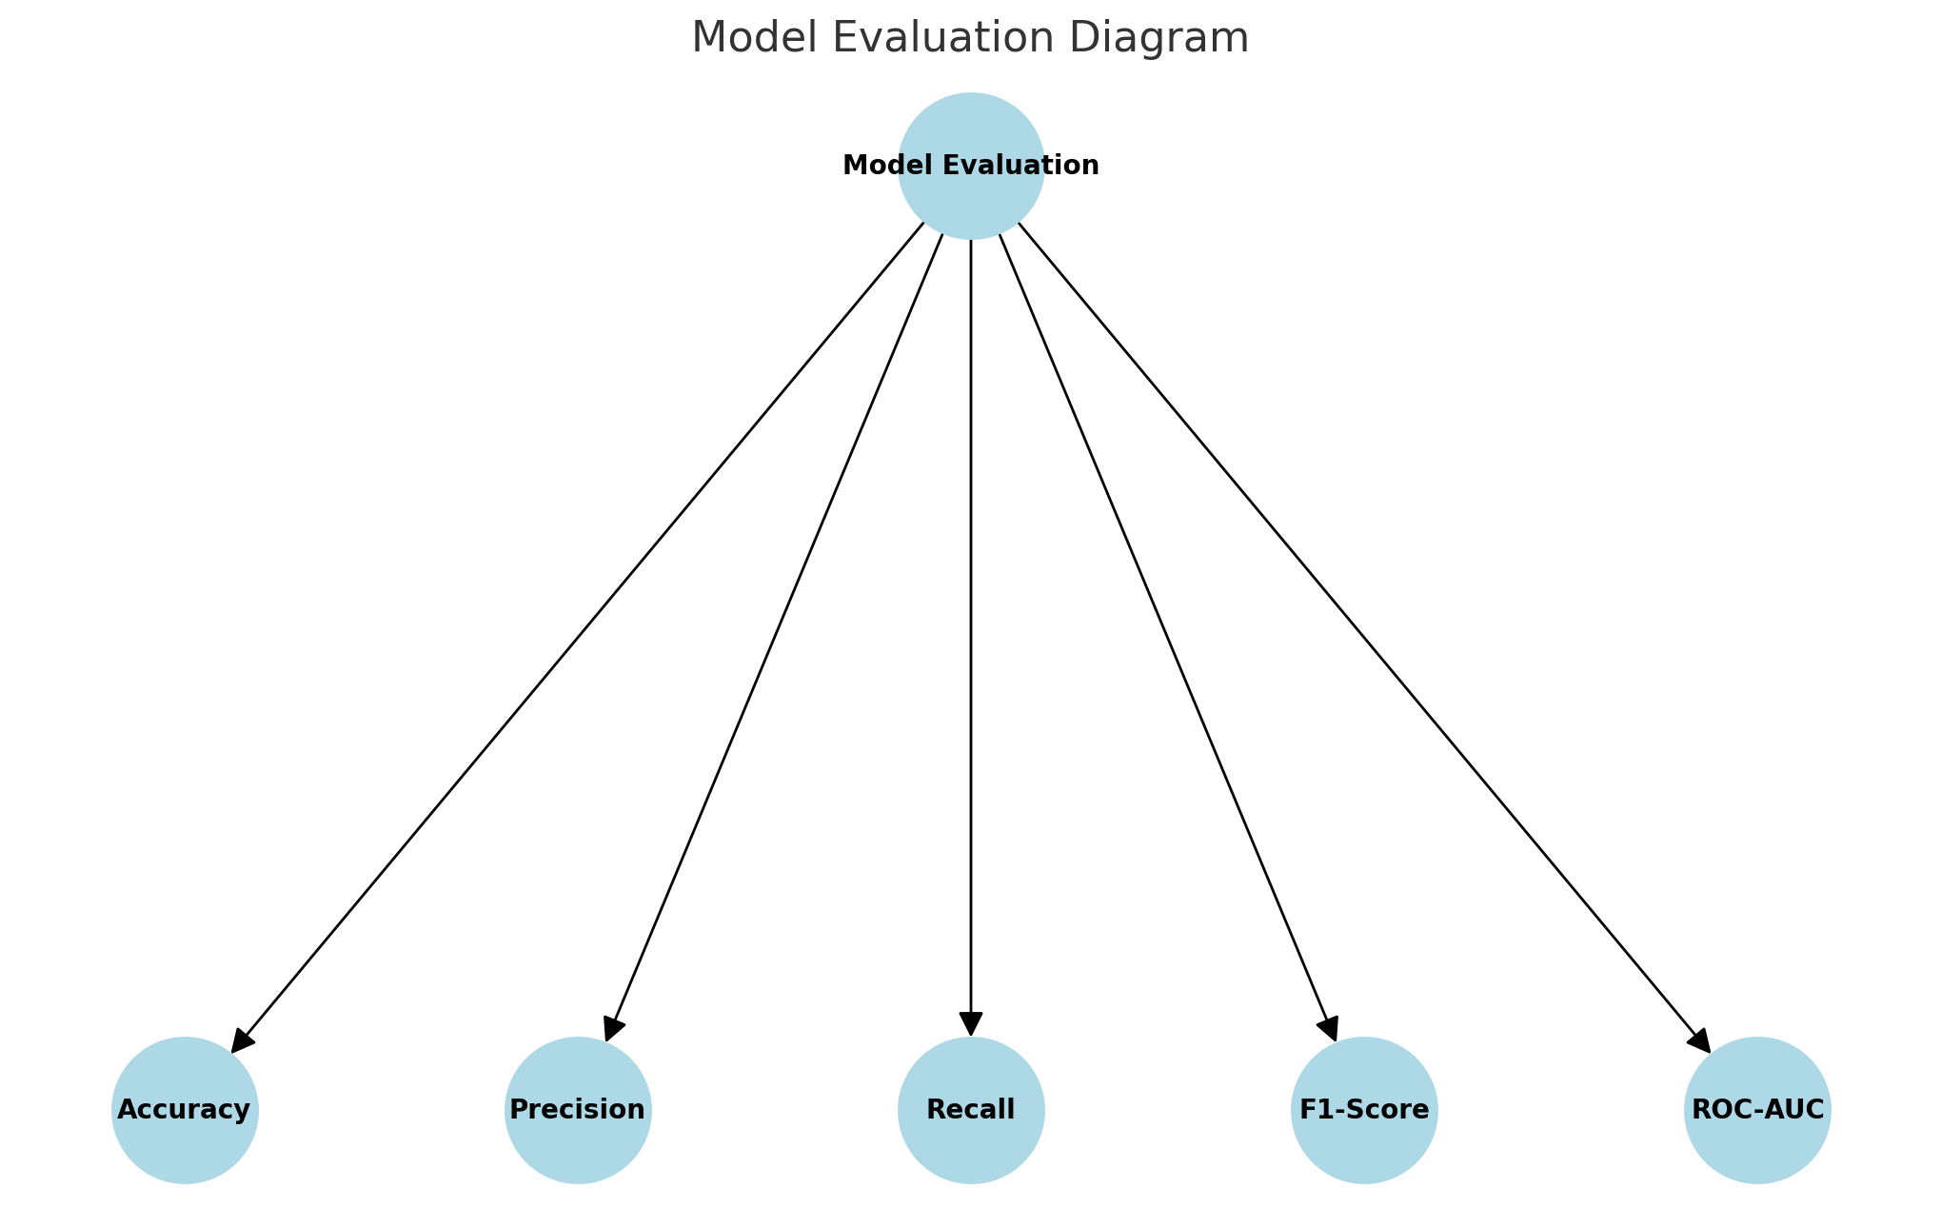
Model evaluation diagram

Slide 7
Data Preprocessing
Handling Missing Values: Impute missing values using methods like mean/mode/median imputation or more sophisticated techniques like KNN imputation.
Normalization/Standardization: Scale features to a standard range using techniques like MinMaxScaler or StandardScaler.
Encoding Categorical Variables: Convert categorical variables to numerical values using one-hot encoding or label encoding.

Slide 8
Feature Engineering
Creating New Features: Derive new features from existing data, such as BMI from height and weight, or age groups.
Feature Selection: Use techniques like correlation matrix, Recursive Feature Elimination (RFE), or feature importance from tree-based models to select relevant features.

Slide 9

Model Selection
Algorithms Considered:
Logistic Regression: A simple yet effective linear model for binary classification.
Decision Trees: A non-linear model that splits data based on feature values.
Random Forest: An ensemble method that combines multiple decision trees.
Support Vector Machine (SVM): A model that finds the optimal hyperplane for classification.
Neural Networks: Deep learning models that can capture complex patterns in data.

Slide 10
Model Training
Data Splitting: Divide the dataset into training and test sets, typically using an 80-20 split.
Cross-Validation: Use k-fold cross-validation to ensure the model generalizes well to unseen data.

Slide 11
Model Evaluation
Evaluation Metrics:
Accuracy: The percentage of correctly predicted instances.
Precision: The ratio of true positive predictions to the total predicted positives.
Recall: The ratio of true positive predictions to the total actual positives.
F1-Score: The harmonic mean of precision and recall.
ROC-AUC: The area under the Receiver Operating Characteristic curve, indicating the model's ability to discriminate between classes.

Slide 12
Progress and Milestones
Data Collection and Preprocessing: Completed
Collected datasets from UCI and Kaggle.
Handled missing values, normalized/standardized data, and encoded categorical variables.
Feature Engineering: Completed
Created new features and selected relevant ones.
Model Selection and Training: Ongoing
Evaluated various models using cross-validation.
Trained the best model.
Model Evaluation: Upcoming
Evaluate the final model using test data.
Tune the model for better performance.

Slide 13
References
Dataset Links:
Heart Disease UCI Dataset on Kaggle
Cardiovascular Disease Dataset
Sources: List any academic papers, articles, or resources used in your research.
This content covers the necessary details of your methodology and code implementation, ensuring a comprehensive explanation of your project.

Slide 14

Thank you

